Slide 1
Secure data hiding in images using steganography
CAPSTONE PROJECT
Presented By : Apoorva Satakolla
Student Name : Apoorva Satakolla
College Name & Department : Gokaraju Rangaraju Institute of Engineering & Technology - CSE

Slide 2
OUTLINE
Problem Statement
Technology used
Wow factor
End users
Result
Conclusion
Git-hub Link
Future scope

Slide 3
Problem Statement
With the increasing need for secure data transmission in the digital age, protecting sensitive information from unauthorized access has become a significant challenge. Traditional encryption methods can raise suspicion during data transfer. This project, "Secure Data Hiding in Images Using Steganography," aims to develop a tool that embeds secret messages within images, making the hidden data undetectable to unintended recipients.

Slide 4
Technology used
Libraries:
OpenCV (cv2): For image processing and manipulation.
os: To interact with the operating system for tasks like opening files automatically.
Platform:
Programming Language: Python
Development Environment: Visual Studio Code (VS Code), PyCharm, or any Python-supported IDE
Version Control: Git and GitHub for code management and collaboration
Operating System: Compatible with Windows, macOS, and Linux (though automatic image opening is currently windows-specific)

Slide 5
Wow factors
Passcode-Protected Encryption: Unlike basic steganography tools, this project adds an extra layer of security by requiring a passcode for both encryption and decryption, ensuring only authorized users can access the hidden data.
Pixel-Level Data Embedding: The tool embeds secret messages directly into pixel values, making the hidden data almost impossible to detect without specialized tools.
Lightweight and Fast Processing: The use of OpenCV ensures efficient image processing, allowing quick embedding and extraction of hidden messages.
Automatic Image Display: Once the encryption is done, the encrypted image opens automatically for easy verification, enhancing user experience.
Simple Yet Effective UI: Command-line prompts make it easy for users of all skill levels to interact with the tool without needing advanced technical knowledge.
Potential for Future Enhancements: The modular code structure allows easy integration of advanced features like AES encryption, different image formats support, or GUI development.

Slide 6
End users
Cybersecurity Professionals: To securely transmit confidential information without drawing attention during data transfer.
Businesses and Corporations: For protecting sensitive internal communications, contracts, or financial data shared over digital platforms.
Researchers and Academicians: To safeguard intellectual property, research findings, or confidential academic data.
Government and Intelligence Agencies: For securely transmitting classified information in a discreet manner.
Developers and Tech Enthusiasts: As a learning tool to understand steganography, encryption, and basic image processing techniques.

Slide 7
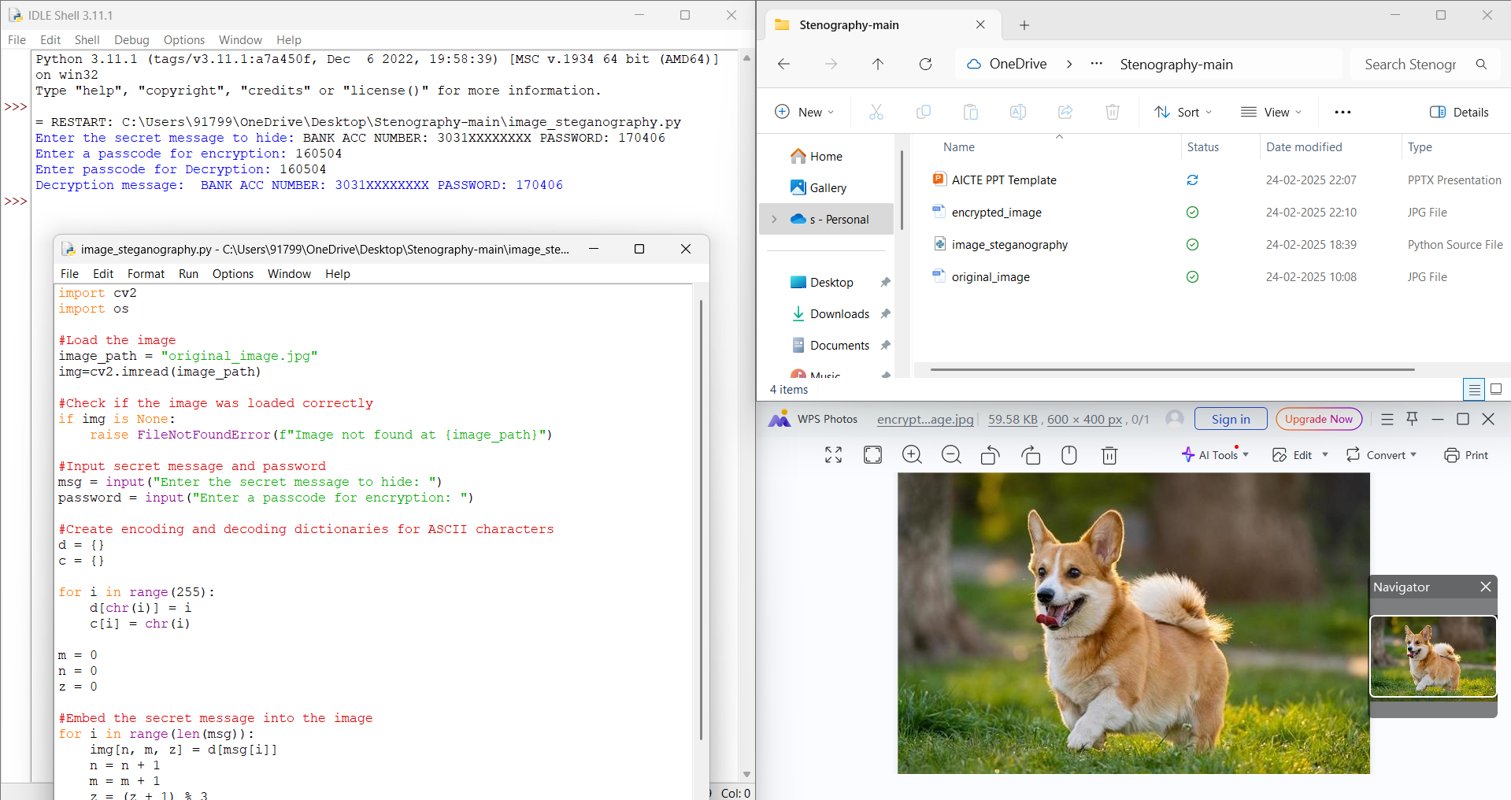
Results

Slide 8
Conclusion
In an era where data security is of utmost importance, this project, "Secure Data Hiding in Images Using Steganography," offers an effective solution for safeguarding sensitive information. By embedding secret messages within images and securing them with a passcode, the tool ensures both discretion and protection against unauthorized access. This method not only hides the existence of the data but also adds an extra layer of security, making it ideal for secure communication. The project successfully addresses the challenge of covert data transmission, providing a simple yet powerful tool for users across various sectors, including cybersecurity, business, and research.

Slide 9
GitHub Link
https://github.com/Apoorva-Satakolla/image-stego-secure.git

Slide 10
Future scope(optional)
Advanced Encryption Integration: Incorporate stronger encryption algorithms like AES or RSA for added security alongside steganography.
Support for Multiple File Formats: Extend functionality to support various image formats (PNG, BMP, TIFF) and even audio or video steganography.
Graphical User Interface (GUI): Develop a user-friendly GUI to make the tool more accessible to non-technical users.
Cross-Platform Compatibility: Enhance compatibility for mobile platforms (Android/iOS) for on-the-go secure messaging.
Data Capacity Optimization: Improve algorithms to maximize the amount of hidden data without affecting image quality.
Steganalysis Resistance: Implement techniques to make hidden data undetectable even under steganalysis attacks, ensuring stronger security.

Slide 11
THANK YOU

